Slide 1

Electromagnetic Waves
CSF Third Year
Active Learning Presentation on Wireless Mobile & Device Security
Presented By: Krishnaraj Thadesar PA10, Vedang Khare PA06,
Saubhagya Singh PA24, Sourab Karad PA25

Slide 2
Table of contents
01.
02.
03.
04.
05.
06.
Introduction
Properties
Types
You can describe the topic of the section here
You can describe the topic of the section here
You can describe the topic of the section here
Properties
Interactions
Activities
You can describe the topic of the section here
You can describe the topic of the section here
You can describe the topic of the section here

Slide 3
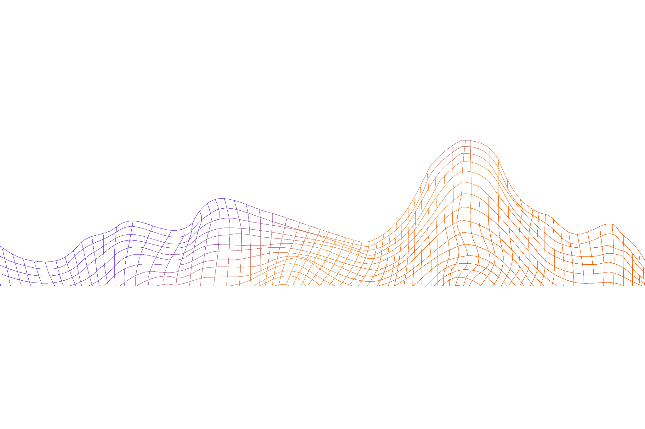
01.
Introduction to EM Waves
PA06. Vedang Khare

Slide 4




Our team
Vedang
Khare
Saubhagya
Singh
Sourab
Karad
Krishnaraj
Thadesar
Introduction
And Explanation
Demo and Hacking
Technological
Advancements
Applications of EM Waves

Slide 5
Introduction To Electromagnetic Waves
Electromagnetic waves are a fundamental concept in science and technology. They are a type of wave that is created by the movement of electric and magnetic fields. These waves can travel through space and are responsible for many of the technologies that we use every day, including radio, television, and cell phones.
Electromagnetic waves have a wide range of applications in fields such as medicine, telecommunications, and astronomy. Understanding the properties of these waves is essential to understanding how they work and how they can be used to improve our lives.

Slide 6
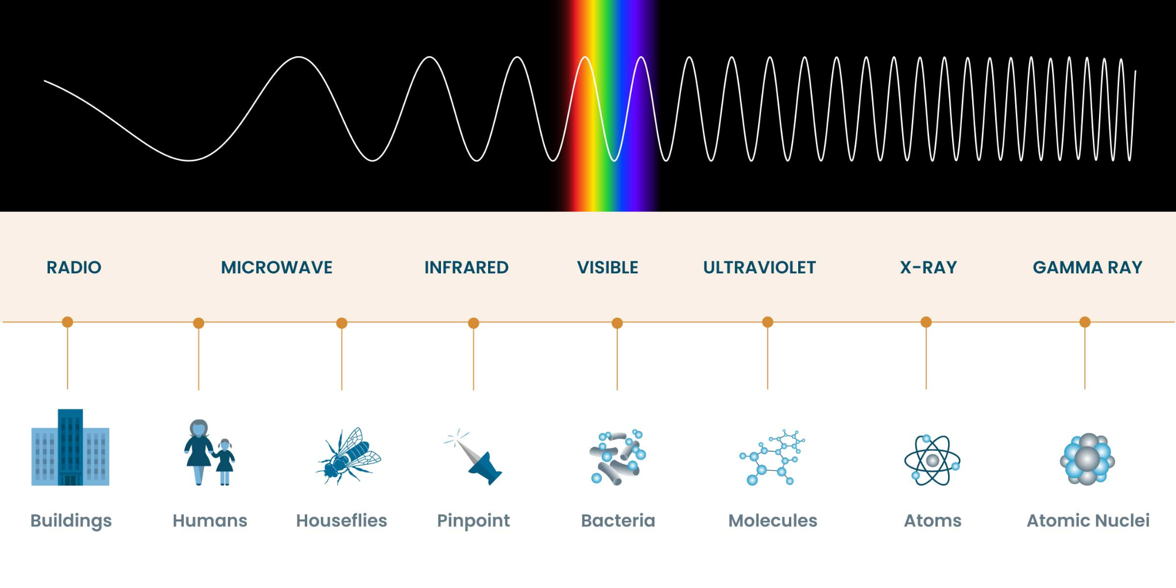

Slide 7
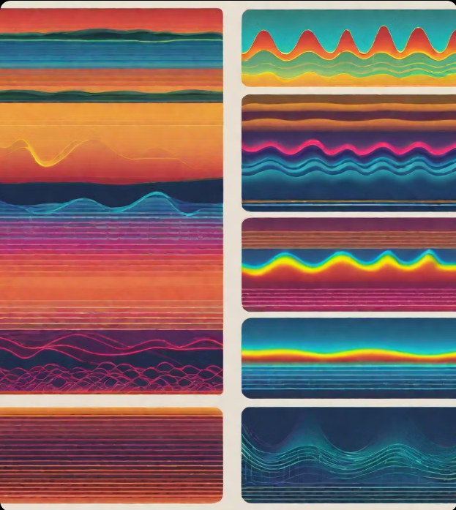
A Brief History
The study of electromagnetic waves dates back to the 19th century, when James Clerk Maxwell formulated the theory of electromagnetism. This theory predicted the existence of electromagnetic waves, which were later discovered by Heinrich Hertz in 1887.

Slide 8
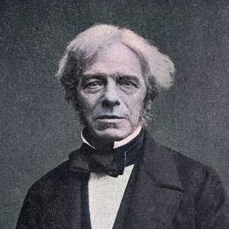
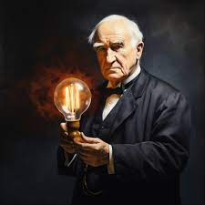
The Father of Electricity
Other notable scientists who contributed to the understanding of electromagnetic waves include Michael Faraday, who discovered electromagnetic induction, and Thomas Edison, who developed the first practical light bulb using a carbon filament.

Slide 9
02.
Different Sections of the Spectrum
A Brief Description about all the different sections of the EM Spectrum

Slide 10
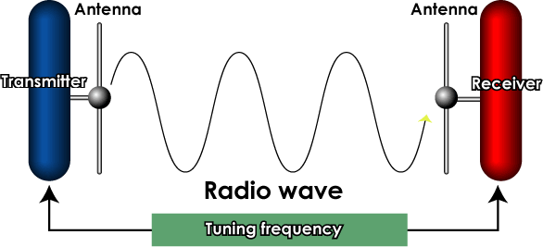
Radio Waves
Radio waves have the longest wavelengths and the lowest frequencies in the electromagnetic spectrum. They are used for communication, such as radio and television broadcasting, cell phone signals, and GPS navigation.

Slide 11
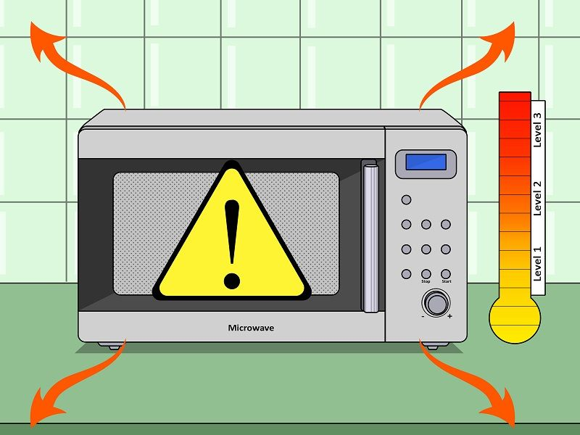
Microwaves
Microwaves have shorter wavelengths and higher frequencies than radio waves. They are used for communication, such as satellite and microwave transmission, as well as cooking food in microwave ovens.

Slide 12
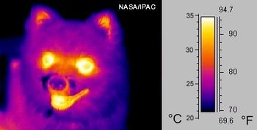
Infrared
Infrared radiation has longer wavelengths and lower frequencies than visible light. It is used for heating, such as in infrared heaters, as well as for remote sensing, such as in thermal imaging cameras.

Slide 13

Visible Light
Visible light is the only section of the electromagnetic spectrum that can be seen by the human eye. It has a range of wavelengths and frequencies, with each color corresponding to a different wavelength. Visible light is used for illumination and for visual communication.
This is an image taken under Visible Light

Slide 14
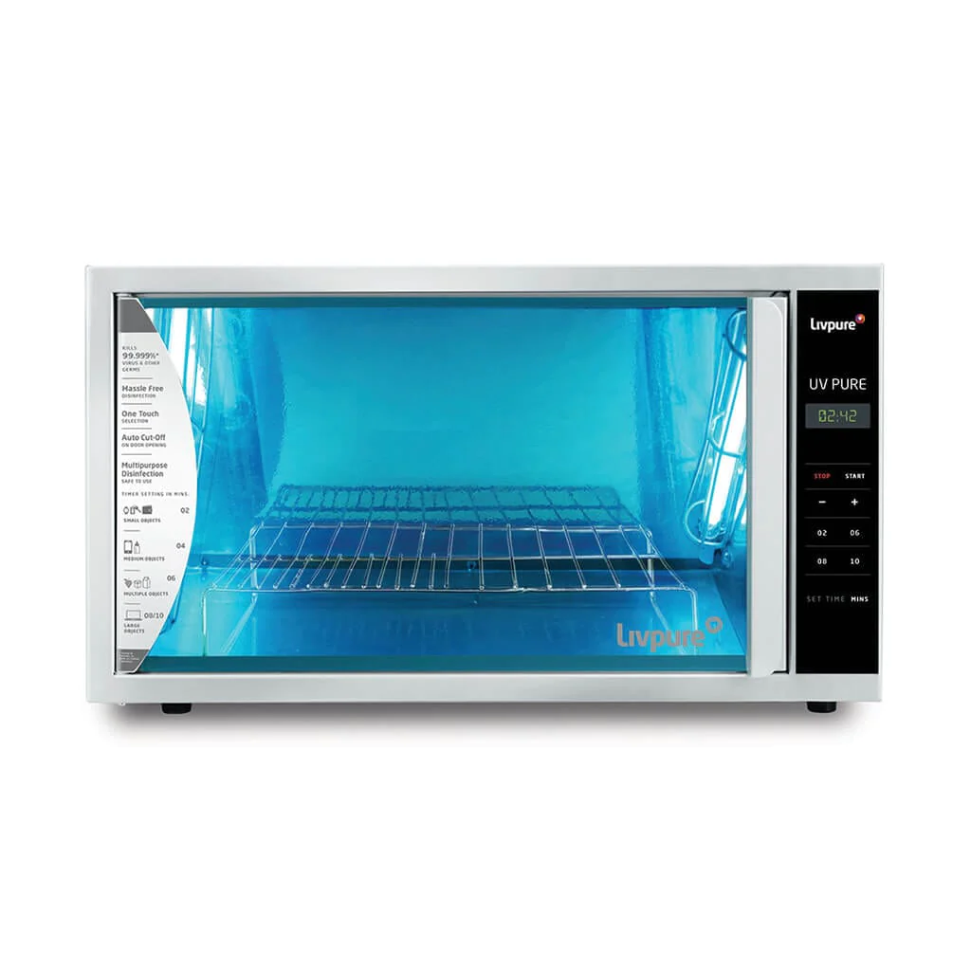
Ultraviolet
Ultraviolet radiation has shorter wavelengths and higher frequencies than visible light. It is used for sterilization, such as in hospitals and water treatment plants, as well as for tanning and black lights.

Slide 15
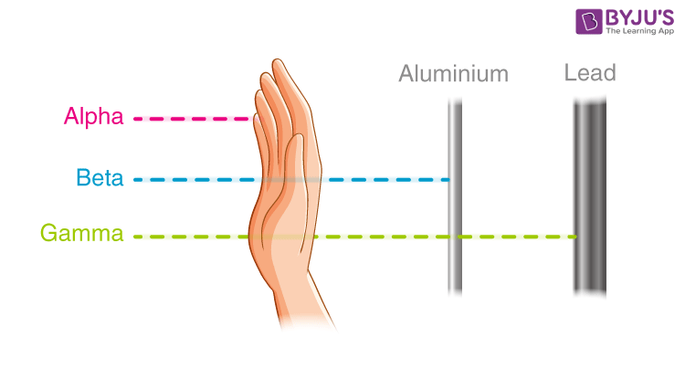
X-rays and Gamma Rays
X-rays and gamma rays have the shortest wavelengths and the highest frequencies in the electromagnetic spectrum. They are used for medical imaging, such as X-ray and CT scans, as well as for radiation therapy and in nuclear medicine.

Slide 16
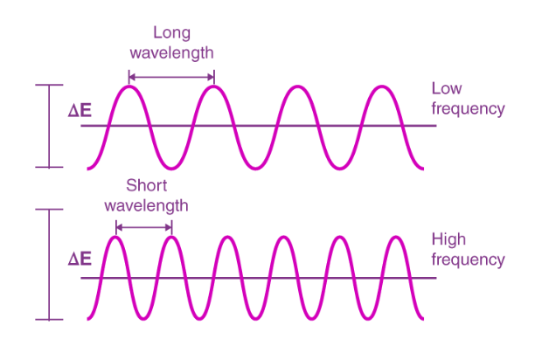
Wavelengths And Frequencies
Electromagnetic waves are characterized by their wavelengths and frequencies. Wavelength is the distance between two consecutive peaks or troughs of a wave, while frequency is the number of waves that pass a point in a given amount of time. The relationship between wavelength and frequency is inverse; as wavelength increases, frequency decreases, and vice versa.

Slide 17
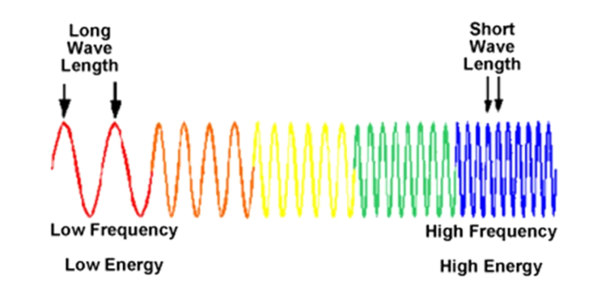
Short Wavelength = High Energy
Shorter wavelengths have higher frequencies and more energy. For example, gamma rays have the shortest wavelengths and highest frequencies, while radio waves have the longest wavelengths and lowest frequencies.The electromagnetic spectrum is divided into different sections based on wavelength and frequency. These sections include radio waves, microwaves, infrared, visible light, ultraviolet, X-rays, and gamma rays.

Slide 18
03.
Application of EM waves
PA10. Krishnaraj Thadesar

Slide 19
Wireless Communication Security
The use of electromagnetic waves, particularly radio waves, to implement encryption measures and protect wireless communication channels from unauthorized access or interception.
Secure Data Transmission: EM waves, especially radio waves, are applied to secure wireless communication channels through encryption protocols, ensuring the confidentiality of transmitted data.
Prevention of Unauthorized Access: Utilizing EM waves helps prevent unauthorized access and eavesdropping, enhancing the overall security of wireless networks.

Slide 20
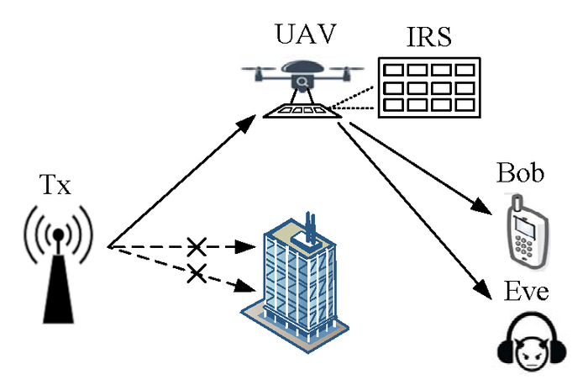

Slide 21
2. RFID Technology
The application of electromagnetic waves, particularly radio frequencies, for the purpose of identifying and tracking objects in a variety of industries, leading to improved operational efficiency.
Object Identification: EM waves, in the form of radio frequency signals, are used in RFID technology to identify and track objects efficiently, providing benefits in supply chain visibility and inventory control.
Enhanced Management: RFID enables the efficient tracking and management of tagged items, enhancing processes such as inventory management and logistics.

Slide 22

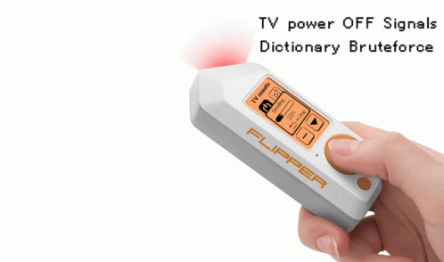
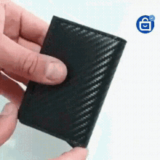


Slide 23
3. Mobile Phone Networks
The utilization of electromagnetic waves, particularly microwaves, in the infrastructure of mobile networks to enable efficient data transmission and reliable communication between cell towers and mobile devices.
Data Transmission: Microwaves in mobile phone networks facilitate the high-speed transmission of data between cell towers and mobile devices, supporting the growing demand for mobile data services.
Reliable Communication: EM waves play a crucial role in ensuring reliable and fast communication in mobile phone networks, contributing to the seamless operation of mobile services.

Slide 24
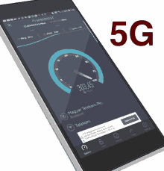

Slide 25
4. Wireless Keyboards and Mice
The use of electromagnetic waves to establish wireless communication between computers and input devices, such as keyboards and mice, offering users a more flexible and uncluttered computing experience.
Cable-Free Peripherals: EM waves enable wireless communication in keyboards and mice, providing users with cable-free peripherals for increased flexibility and convenience.
Addressing Workspace Needs: The application of EM waves in wireless peripherals addresses the need for cable-free solutions, improving workspace organization and reducing clutter.

Slide 26
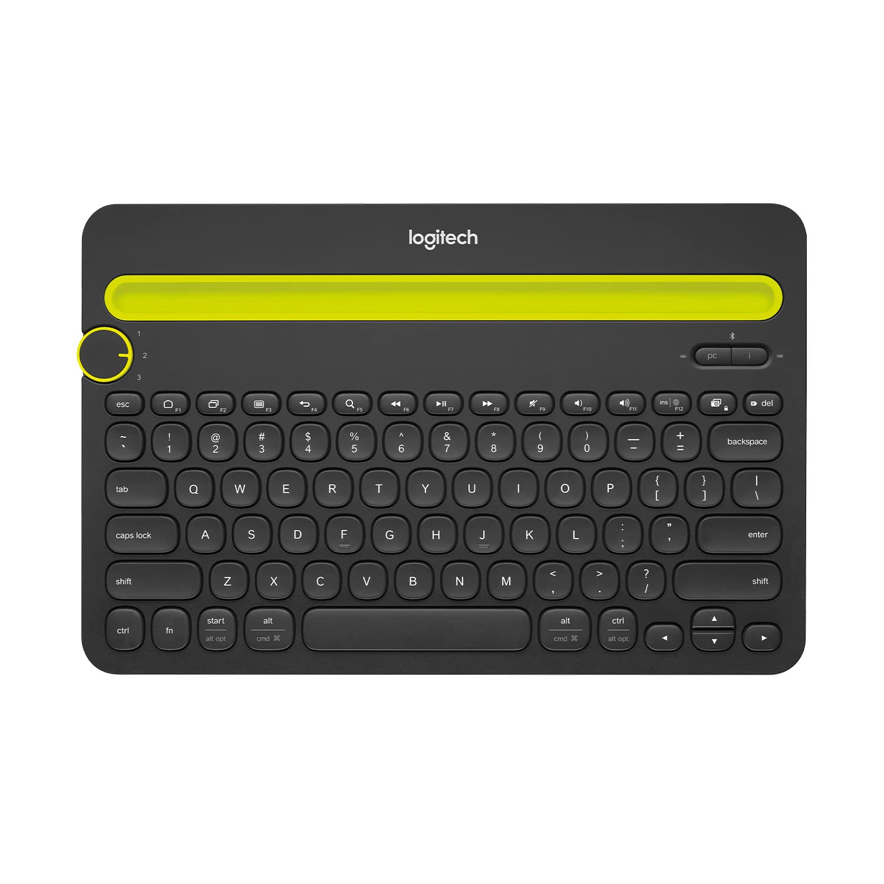


Slide 27
5. Jamming and Spoofing Detection
The utilization of electromagnetic wave analysis to identify and counteract security threats, such as jamming and spoofing, in wireless communication, enhancing the overall security of networks.
Security Threat Mitigation: EM wave analysis is applied to detect and mitigate security threats such as jamming and spoofing attempts in wireless communication, safeguarding the integrity of communication channels.
Counteracting Unauthorized Activities: The detection of attempts to disrupt or manipulate EM waves helps counteract unauthorized activities, preventing potential threats to wireless networks.

Slide 28

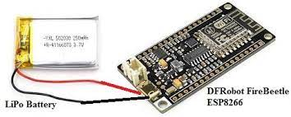
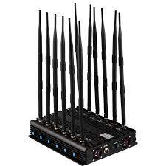
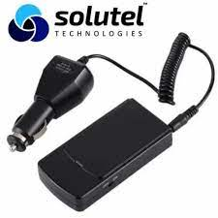

Slide 29
6. Faraday Cages for Mobile Security
The application of EM wave principles in constructing Faraday cages to isolate mobile devices from external electromagnetic signals, ensuring a secure environment for sensitive operations.
Isolation from External Signals Faraday cages, utilizing EM wave principles, isolate mobile devices from external electromagnetic signals, providing a secure environment for sensitive operations.
Security in Controlled Spaces The application of Faraday cages enhances security in controlled spaces by blocking external EM signals and preventing potential security breaches.

Slide 30


Slide 31
7. Electromagnetic Pulse (EMP) Shielding
The use of electromagnetic wave shielding to protect electronic devices and critical infrastructure from damage caused by electromagnetic pulses (EMPs), ensuring the continued reliability of electronic systems.
Protection from EMP Attacks: EM wave shielding is applied to protect electronic devices from damage caused by electromagnetic pulses, safeguarding critical infrastructure from potential EMP attacks.
Ensuring Electronic System Reliability: The application of EM wave shielding ensures the reliability of electronic systems in challenging environments, preventing disruptions caused by EMP events.

Slide 32
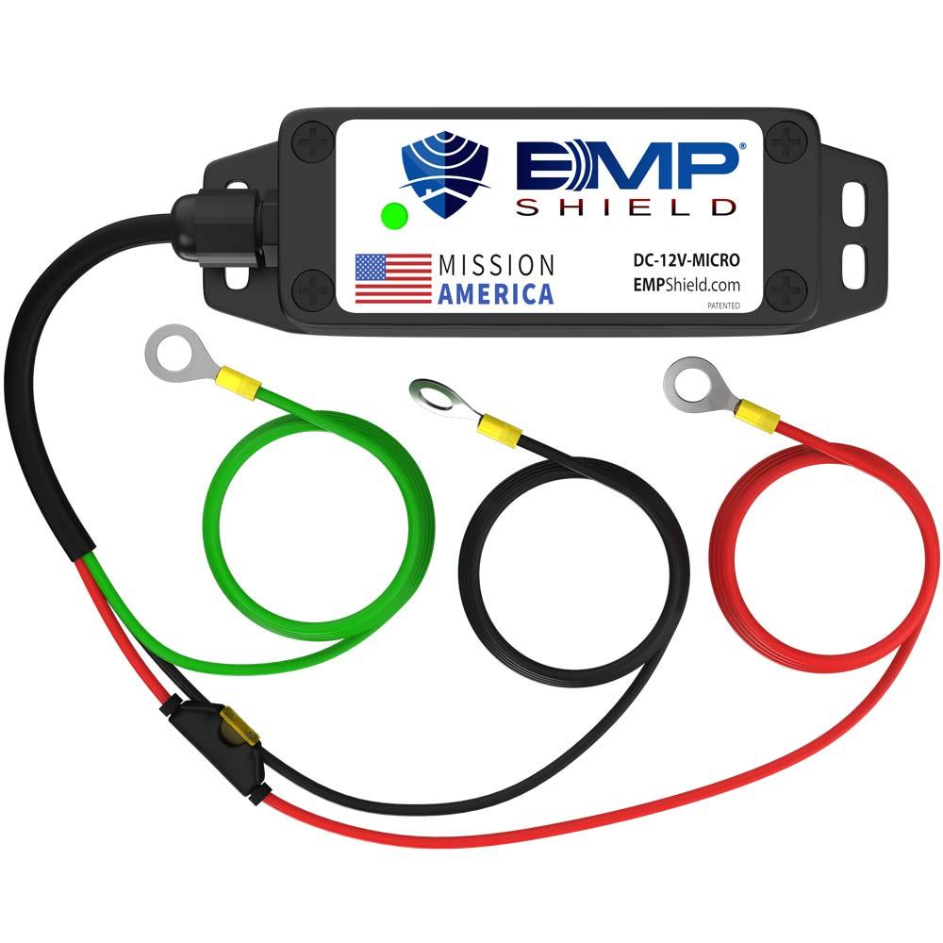

Slide 33
Other Vital Uses
Medical Imaging
Broadcasting and Television
Satellite Communication
Radar Systems
Global Positioning System (GPS)
Wireless Power Transmission
Industrial Heating and Processing
Non-Destructive Testing
Environmental Monitoring
Wireless Sensor Networks

Slide 34
04.
Exploitation for Hacking
PA24. Saubhagya Singh

Slide 35
WiFi Hacking in Relation to EM Waves
Electromagnetic waves, including radio waves, are used for transmitting information wirelessly, and Wi-Fi operates within the radio frequency (RF) spectrum. Wi-Fi, short for Wireless Fidelity, is a technology that allows devices to exchange data wirelessly using radio waves within the electromagnetic spectrum.
The relation between electromagnetic waves and Wifi hacking lies in the fact that Wi-Fi signals are a form of electromagnetic radiation, specifically radio waves. When we refer to Wifi hacking, it typically involves unauthorized access to a Wi-Fi network for various purposes, such as eavesdropping on communication, stealing sensitive information, or using the network's resources without permission.

Slide 36
Types of Attacks
Brute Force Attacks
Dictionary Attacks
WPS PIN Attacks
Packet Sniffing
Evil Twin Attacks
Rogue Access Points
Phishing
Man-in-the-Middle Attacks

Slide 37
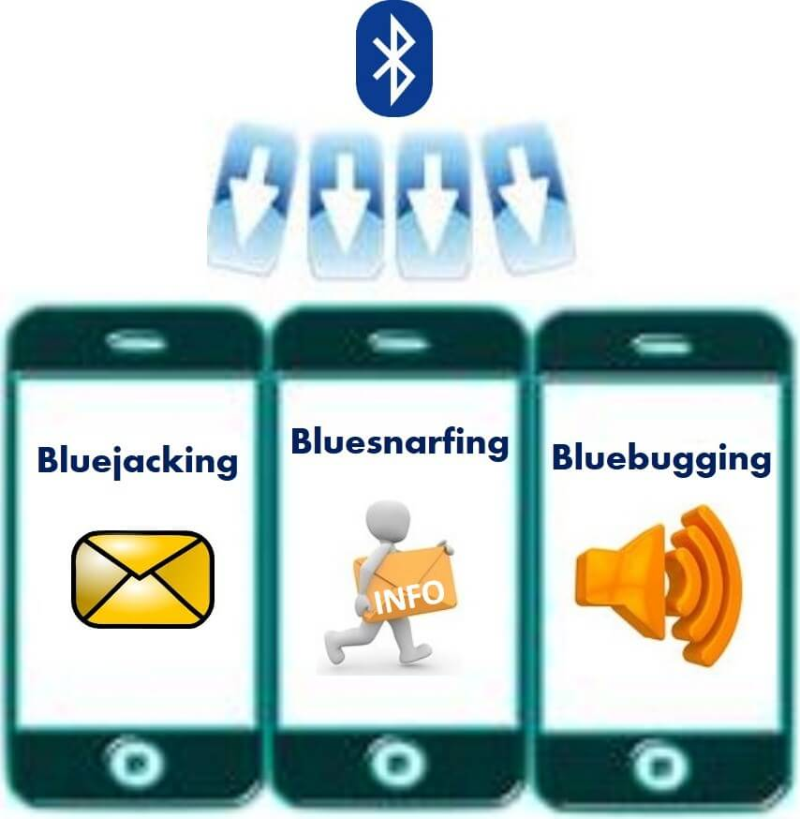
BlueTooth Hacking
Bluejacking:Sending unsolicited messages to Bluetooth devices.
Bluesnarfing:Unauthorized access to information on a Bluetooth device.
Bluebugging:Taking control of a Bluetooth device, including making calls and sending texts.
Denial of Service (DoS) Attacks:Disrupting normal Bluetooth device functioning through overwhelming connection requests.

Slide 38
Bluetooth Hacking Attacks
Bluetooth Honeypot Attacks:Mimicking a legitimate Bluetooth device to attract and monitor attackers.
Bluetooth Sniffing:Eavesdropping on Bluetooth communications to capture sensitive information.
Impersonation (Spoofing) Attacks:Attempting to impersonate a trusted device to gain unauthorized access.

Slide 39

Demo Video: Fern Wifi Hacking Tool

Slide 40

Screenshots of a Phishing Attack

Slide 41

Aaron Philip

Slide 42
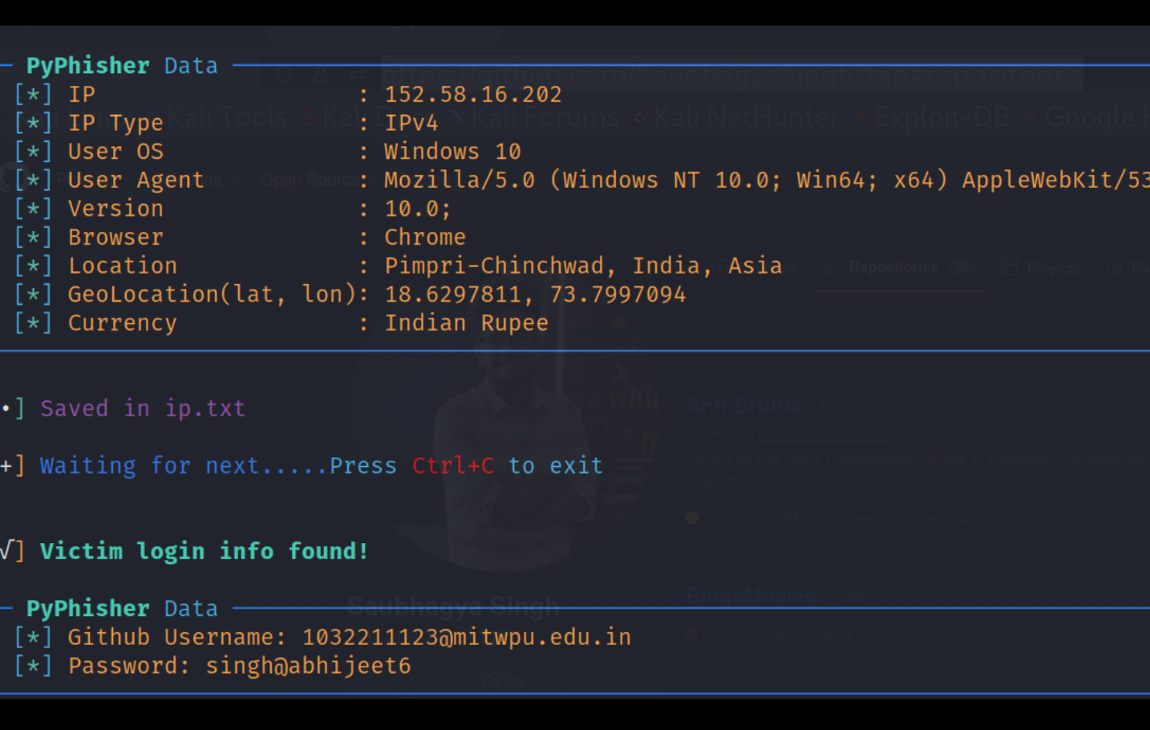
Abhijeet Singh

Slide 43


Slide 44


Slide 45


Vinayak Sir Attempt - Phishing Attack

Slide 46
05.
Developments in Wifi Tech
PA24. Sourab Karad

Slide 47

WiFi 7
Just as WiFi standards have evolved from 802.11a to 802.11ax (WiFi 6), the next standard, possibly called WiFi 7, is anticipated. It would likely bring even higher data rates, improved efficiency, and reduced latency.

Slide 48
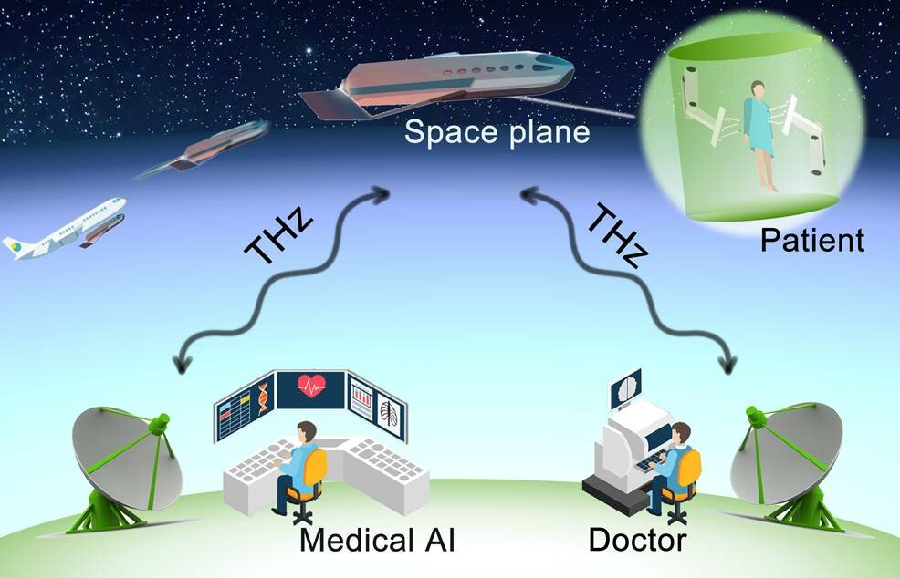
Terahertz (THz) Communication
Research is ongoing in utilizing terahertz frequencies for wireless communication. Terahertz waves have the potential to offer extremely high data rates, but technical challenges need to be addressed for practical implementation.

Slide 49
More future projects on WIFI tech advancements
AI Integration
Mesh Networking
Energy Efficiency

Slide 50
Frequency and electromagnetic wave
For 1g, 2g and 5g

Slide 51
06.
Frequency and electromagnetic waves
For 1g, 2g and 5g

Slide 52
2G (Second Generation)
1G (First Generation)
Frequency Range: Primarily in the 800 MHz and 900 MHz bands.
Modulation: Analog signals for voice communication.
Technology: First-generation mobile networks were based on analog technology, allowing for basic voice communication.
Frequency Range: Ranged from 900 MHz to 1.9 GHz.
Modulation: Digital signals using various modulation techniques.
Technology: 2G introduced digital technologies, enabling not only voice communication but also text messaging (SMS).

Slide 53
Modulation
Technology
5G (Fifth Generation)
Frequency Range:
Utilizes a wide range of frequencies, including low-band (sub-1 GHz), mid-band (1-6 GHz), and high-band (millimeter-wave) frequencies.
Utilizes advanced modulation techniques, including higher-order modulation, massive MIMO, and beamforming.
5G represents a significant advancement, offering higher data rates, lower latency, and increased device density. It utilizes a mix of frequency bands to balance coverage and capacity.

Slide 54
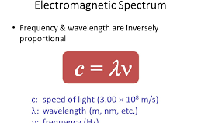
How Frequency Affects Speed
Frequency plays a crucial role in determining the speed and data-carrying capacity of a communication system, including wireless technologies like WiFi and mobile networks. Here are the key ways in which frequency affects speed:

Slide 55
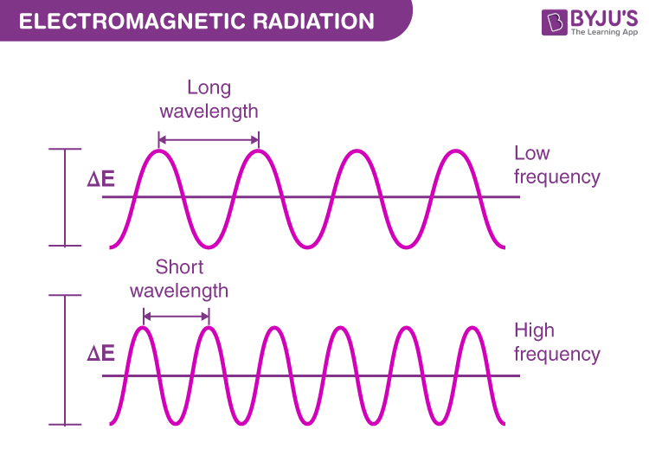
Wavelength and Frequency Relationship
Frequency and wavelength are inversely proportional. Higher frequency corresponds to shorter wavelengths, and lower frequency corresponds to longer wavelengths. This relationship is described by the equation:
c=fλ, where
c is the speed of light,
f is the frequency, and
λ is the wavelength.x`

Slide 56
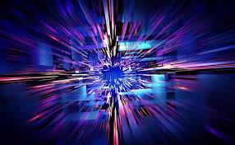
Data Transfer Rates
In the context of wireless communication, higher frequencies generally allow for higher data transfer rates. This is because more cycles of the electromagnetic wave can be transmitted per unit of time

Slide 57
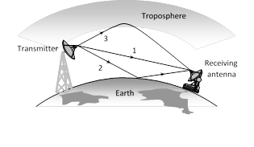
Propagation Distance
Higher frequencies often result in shorter propagation distances. This is due to factors like increased absorption by atmospheric gases and higher susceptibility to obstacles. Lower frequencies, on the other hand, can propagate over longer distances.

Slide 58
Why 5g and 6g are faster?
Higher Frequencies (Millimeter Waves)
Advanced Modulation Techniques
These higher frequencies provide a larger bandwidth, allowing for faster data transmission
5G employs advanced modulation techniques, such as higher-order modulation (e.g., 256-QAM), allowing more data to be encoded in each transmission
Massive MIMO (Multiple Input, Multiple Output)
Beamforming
Beamforming allows the focused transmission of signals in specific directions, optimizing signal strength and quality.
Massive MIMO involves the use of a large number of antennas at both the transmitter and receiver

Slide 59
Conclusion

Slide 60
Summary and Conclusion

Slide 61
Thanks!
Do you have any questions?

Slide 62

Resources

